Slide 1

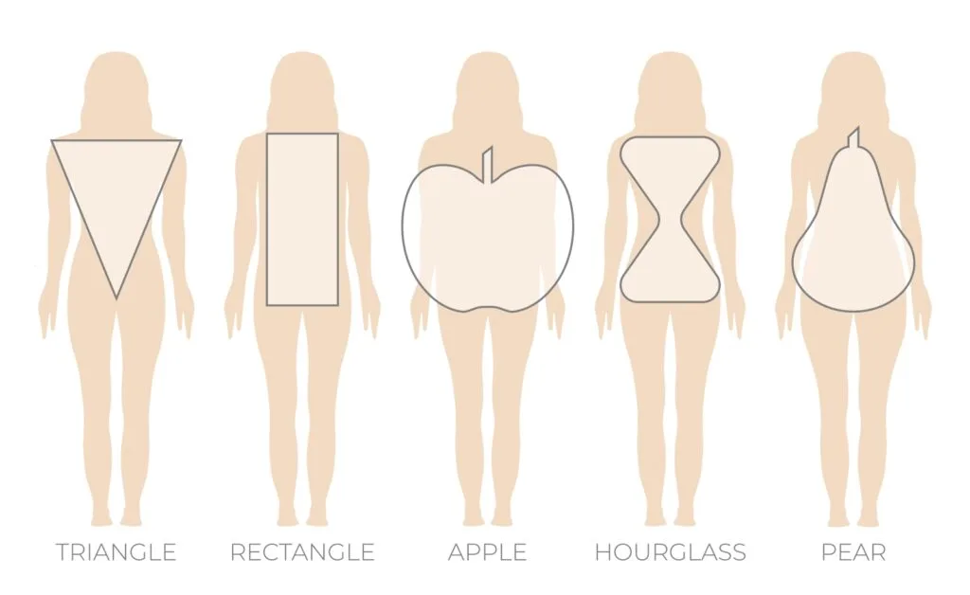


PORTFOLIO
Assignment

Slide 2



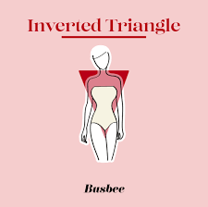
Inverted Triangle: This shape is characterized by a broader chest or shoulders compared to the hips. If your upper body is wider than your lower body, this might be your shape.

Slide 3




Apple (Round or Oval):-
An apple shape is typically wider around the middle with a less defined waist, often accompanied by slimmer legs and arms.

Slide 4


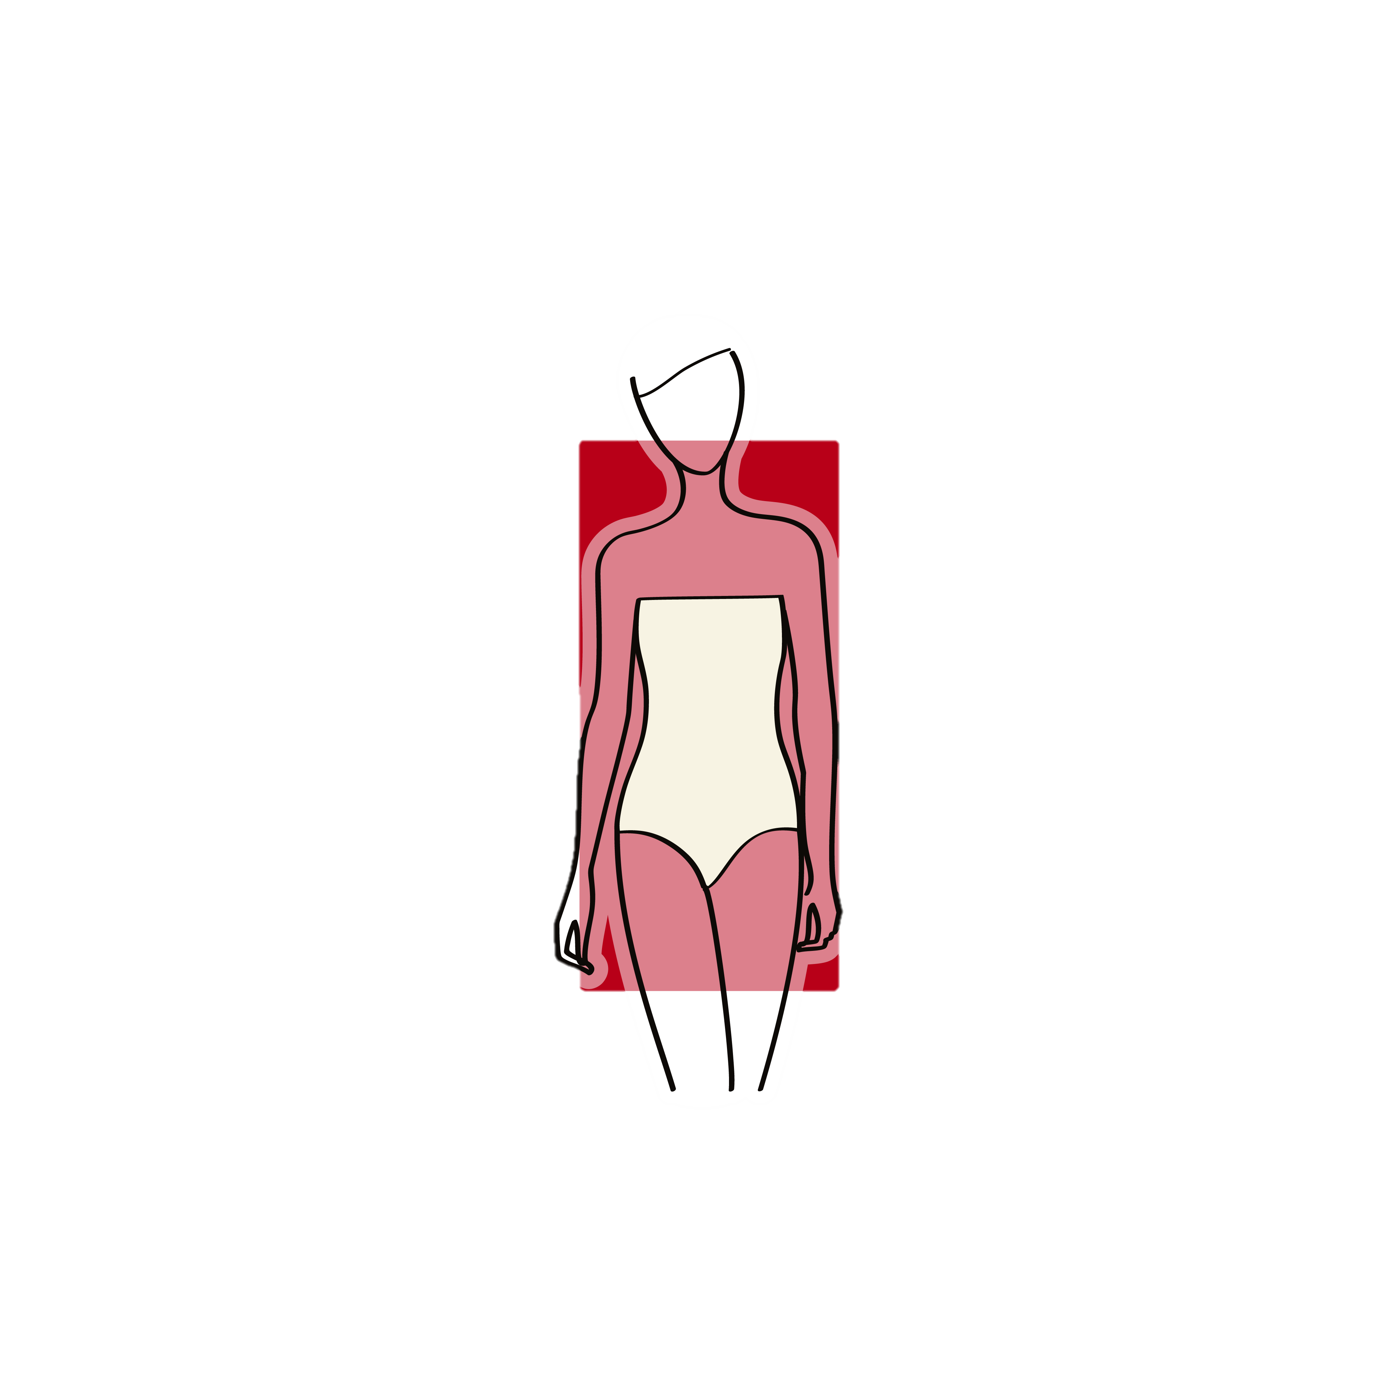

■ Rectangle (Straight): If your waist, hip, and bust measurements are relatively similar, you may have a rectangle shape, offering a more straight-lined silhouette.

Slide 5

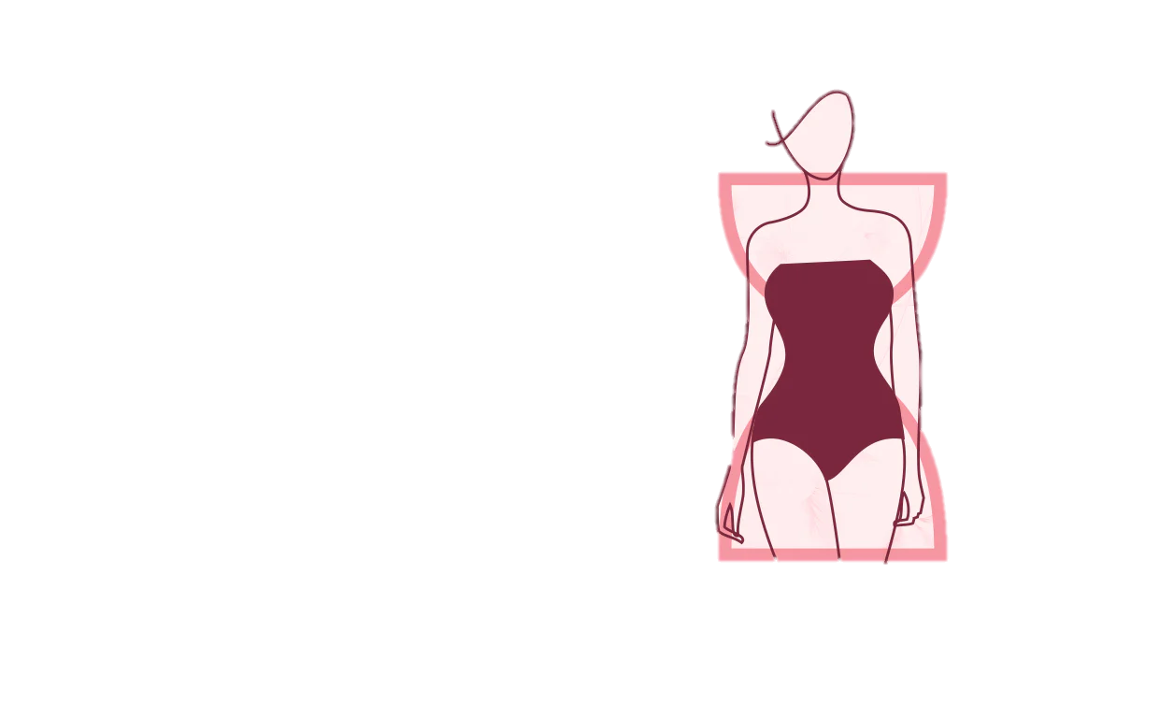
Hourglass:-
This is when both the top and bottom halves of the body are equally broad. People with this body shape tend to have a smaller waist than the chest and hips.

Slide 6
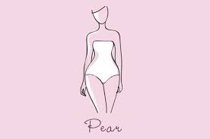
Pear (Triangle): If your hips are wider than both your bust and shoulders, you might be pear- shaped, with weight distributed more towards your lower body.

Slide 7

Thank You

